Slide 1
Hate speech
Unit 1: Identity, stereotypes, prejudice and discrimination

Slide 2
Identity
Identity is what makes us similar to some people and at the same time it is what makes us different from other people.
We are all different because we all have qualities that make every one of us a separate person.
This is called ‘personal identity’. Personal identity is that ‘thing’ that makes you different from all other people.

Slide 3
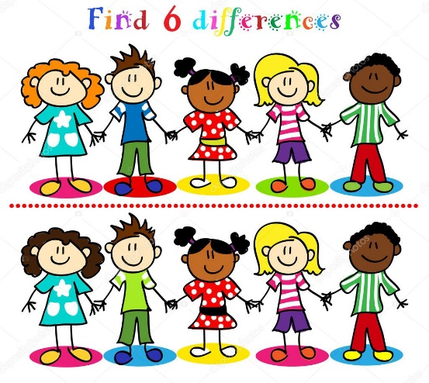
Exercise 1
Activity 1 How do you describe yourself?
Approx. 20 min+Flipchart paper and markers
Think about how you identify yourself?
Think of situations where you might identify yourself:
By ethnicity? (for example - I am a Traveller)
By age? (for example - I am fifteen)
By family background? (for example - I live with my father and have three brothers)
By disability status (for example - I have a disability)
By sexuality? (for example - I am heterosexual)
By relationship to others? (for example - I am a friend/granddaughter/pupil)
By skin colour? (for example - I am a Black person)
By religion? (for example - I am a Catholic)
By gender? (for example - I am a woman)
By nationality? (for example - I am Irish)

Slide 4
Group Identity
Most people identify with certain groups of people to which they feel they belong. Membership of these groups informs their behavior, provides them with self-esteem and shapes beliefs, values and relationships.
Most people can and do belong to a number of social groups.
We can act differently from situation to situation. We are all complex. There are times when one aspect of our social identity becomes more dominant than another. For example, most of us will seek out people of a similar age when we join a youth group. Similarly, at international sporting events, we tend to identify with the country we are supporting.

Slide 5
Exercise 2
Please explore the following concepts relating to a person’s social identity - their meaning to individual members, how important they are to a person’s identity - in group discussion.
Think about how naming different aspects of various social groups may influence how a person is perceived by others?
Discuss with the group whether it is possible to ‘know’ enough about a person based on one, two or more aspects of their identity?
PLEASE NOTE: You can carry out this exercise without asking for personal information from the participants. Participants may choose to ‘invent’ their social identities.

Slide 6
Reference
The Equality Authority and The National Youth Council of Ireland, 2008 – Stereotyping of Young People Resource Pack, Activity sheet 1/p.1-2.: https://www.youth.ie/wp-content/uploads/2018/11/STEREOTYPING-of-Young-People-RESOURCE-PACK.pdf

Slide 7
Differences between
Stereotypes
Widely held but fixed and oversimplified image or idea of a particular type of person or thing
Prejudice
preconceived opinion that is not based on reason or actual experience.
Discrimination
the unjust or prejudicial treatment of different categories of people, especially on the grounds of race, age, or sex.
(https://www.lexico.com/en/definition/)

Slide 8
Stereotypes
Stereotypes can be negative and/or positive.
Stereotypes do not necessarily need to be negative. Many stereotypes attribute positive qualities to entire groups, such as “Jamaicans are really relaxed” or “gay men have fantastic fashion sense”.
While positive stereotypes may seem harmless enough it is important to recognize that all stereotypes are problematic because they tend to be patronizing in tone and damaging in effect.
For example, belief in the stereotypical notion that ‘all Asians are brilliant at school’ may lead teachers to presume that all people of Asian origin do extremely well in Maths and other subjects and, therefore, should attempt the higher level papers regardless of the individual person concerned.

Slide 9
Exercise 3
Write up words on a post-it that come into your mind when you hear the word stereotype.
On a second post-it, write down an example of when you last heard or saw somebody stereotyping another person or group of people.
Discuss the words, definitions and examples that the group suggests.
Try and think of a celebrity or person that you know who does not fit with the traditional understanding you may have held in relation to a social group. Discuss.
Form small groups and discuss various instances where stereotyping has had an impact on your life. Remember that these examples can be from everyday life.

Slide 10
Reference
The Equality Authority and The National Youth Council of Ireland, 2008 – Stereotyping of Young People Resource Pack, Activity sheet 2/p.1.,3.: https://www.youth.ie/wp-content/uploads/2018/11/STEREOTYPING-of-Young-People-RESOURCE-PACK.pdf

Slide 11
Prejudice
The intergroup context
The psychological bases of prejudice
This refers to the ways that people in different social groups view members of other groups. Their views may relate to power differences, the precise nature of differences, and whether group members feel threatened by others. These intergroup perceptions provide the context within which people develop their attitudes and prejudices.
These include: people’s key values; the ways they see themselves and others; their sense of social identity, and social norms that define who is included in or excluded from social groups.
Prejudice is more likely to develop and persist where:
groups have different or conflicting key values
others are seen as different
people see their identity in terms of belonging to particular groups, and
their groups discriminate against others.

Slide 12
Prejudice
Manifestations of prejudice
The effect of experience
There are many ways in which prejudice can be expressed. Stereotypes can be positive or negative, and may be linked to a fear that other groups may pose a threat. Some apparently positive stereotypes (as sometimes expressed towards older people or women, for instance) may nonetheless be patronizing and devalue those groups.
Different stereotypes evoke different emotional responses. These include derogatory attitudes or overt hostility. People’s use of language, behavior, emotional reactions and media images can all reflect prejudice too.
This has several dimensions. First, people’s experiences do not always match others’ views about the extent of prejudice. For instance, few people express negative prejudice towards older people, yet older people report high levels of prejudice towards them.
Secondly, contact between groups is likely to increase mutual understanding, though it needs to be close and meaningful contact.
A third factor is the extent to which people wish to avoid being prejudiced. This is based on personal values, a wish to avoid disapproval, and wider social norms. Each of these offers a means for potentially preventing the expression of prejudice and discriminatory behavior.

Slide 13
References
Dominic Abrams, 2010 - Equality and Human Rights Commission Research Report Series, p.3-4.: https://www.equalityhumanrights.com/sites/default/files/research-report-56-processes-of-prejudice-theory-evidence-and-intervention.pdf

Slide 14
Discrimination – Two types
https://images.app.goo.gl/NF97BeikEmUHXxi57

Slide 15
From Image to Action
STEREOTYPES
PREJUDICE
DISCRIMINATION

Slide 16
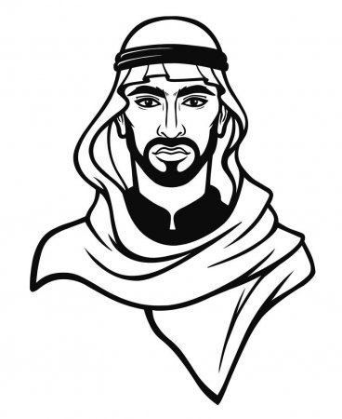
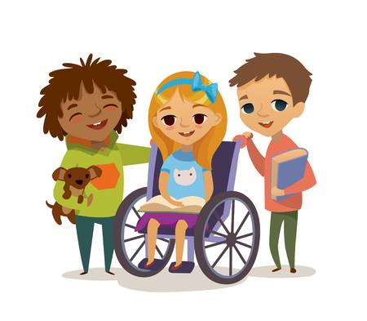
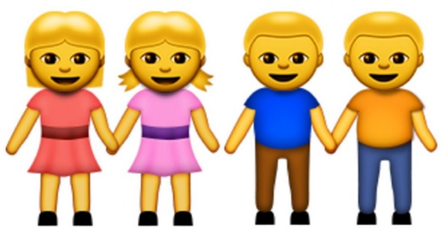
Exercise 4 - Stereotypes
What can you on these pictures?
What is your first impression?

Slide 17
Exercise 5 - Prejudice
What kind of features can you link to these groups of people?

Slide 18
Exercise 6 - Discrimination
How would you react if you have to work, study, live with them?

Slide 19
End of Unit 1

