Slide 1
Fake News
Unit 1: Digital empathy, prejudice and anger
Author: ISES
Version: 2

Slide 2
FAKE NEWS, the definition
The term “fake news” became increasingly common during the past year.
While this concept has many synonyms— disinformation campaigns, cyber propaganda, cognitive hacking, and information warfare —it’s just one facet of the bigger problem: the manipulation of public opinion to affect the real world.
Thanks to the connectivity and digital platforms that make it possible to share and spread information, traditional challenges such as physical borders and the constraints of time and distance do not exist anymore.
Unfortunately, it also makes it easier to manipulate the public’s perception of reality and thought processes, resulting in the proliferation of fake news that affects our real, non-digital environment.
Each new incident shows how much impact the technological manipulation of public opinion can have on people’s daily lives.

Slide 3
Learning outcomes
Upon completing this unit, trainees should be able to:
Critically assess the structural causes and the broad consequences of the news media’s actions in reporting and distributing false information.
Understand and critique the role of technology and the ‘new gatekeepers’ (i.e. the platforms) in enabling the viral distribution of disinformation and misinformation presented as news.
Identify emerging best practices within the news industry for catching and combatting disinformation.

Slide 4
Digital media
Digital media has been heralded as inherently democratizing.
People have direct access to each other across geographical and cultural boundaries. But increasingly it is also seen as a space in which democracy may be simultaneously undermined.
As digital technology increasingly permeates society, there is good reason to pay attention to the institutions, policies, and practices that surround this technology and present both opportunities and threats to democracy.

Slide 5
Digital transformation
In the high-speed information free-for-all on social media platforms and the internet, everyone can be a publisher. As a result, citizens struggle to discern what is true and what is false.
Extreme views, conspiracy theories and populism flourish and once-accepted truths and institutions are questioned. In this world, newsrooms battle to claim and perform their historic role as gatekeepers whose product can help to establish the truth.

Slide 6
The necessary conversation: Digital empathy
By now it should be very clear that social media has very strong effects on the real world. It can no longer be dismissed as “things that happen on the internet”.
What goes on inside Facebook, Twitter, and other social media platforms can change the course of nations.
Neither does it help that social media is driven by subjective factors (i.e., the emotions and feelings of users), instead of objective things like facts. Everyone now has their own truth, which is based on their personal knowledge and experience and not much else.

Slide 7
The fake news triangle
While fake news campaigns are executed slightly differently on each media, in the context of social media and the internet these campaigns rely on three different components to be successful.
We will call this concept the fake news triangle.
Similar to the fire triangle, fake news requires all three factors to be present in order to be successful. The absence of any one of the three factors will make the spread of fake news more difficult, if not impossible.
The Fake News Machine - How Propagandists Abuse the Internet and Manipulate the Public
Lion Gu, Vladimir Kropotov, and Fyodor Yarochkin Forward-Looking Threat Research (FTR)

Slide 8
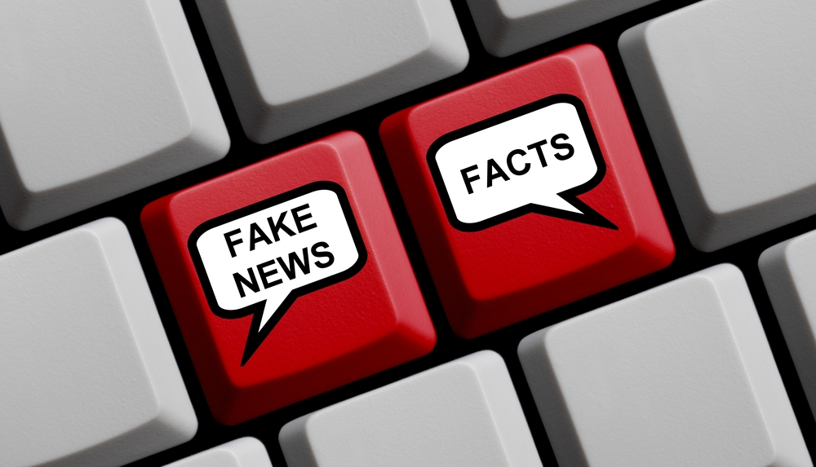
Tools and Services
The rapid growth of social networks caused them to become ideal platforms for spreading disinformation campaigns. Incidents over the past few years demonstrate how social networks are used to distribute fake news. To spread fake news, it is necessary to promote it to social media users.
Notes:
While the use of advertising or other legitimate promotional services might be sufficient for commercial efforts, these would be inadequate for spreading fake news, for several reasons:
Cost. For the reach demanded of fake news campaigns, legitimate advertising is more expensive compared to the costs of fake news (which is important to smaller, less-funded actors)
Anonymity. It is much easier to hide the origin of a fake news campaign compared to paid advertising.
Credibility. News sources may prefer stories spreading “virally” from users, as opposed to spreading through advertisements.

Slide 9
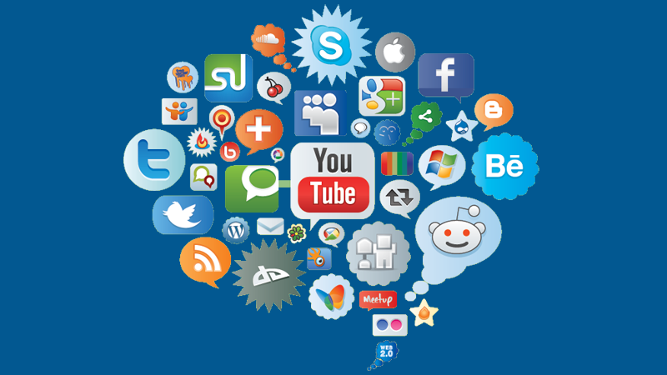
Social Networks
Fake news in its current incarnation would not be possible without social media sites, as these platforms allow users from various countries to connect with other users easily.
The services mentioned above require access to social media sites to spread fake news to actual users. The social media networks have a vested interest in not allowing this access; they would like to keep their sites free of the influence of spammers and propagandists as much as possible. (In extreme cases, social media sites can be fined or even blocked by countries who believe said sites are complicit in spreading fake news).
Notes:
Therefore, social media promoters making up the other leg of the fake news triangle resort to other means to maintain their social media activity, such as bots, or coopting actual users. These social media posts also have to attract the target readers of the fake news operation. To do this, the fake news posts are crafted to appeal to its readers’ psychological desires—confirming biases, the hierarchy of needs, etc. In addition, some services use crowdsourcing mechanisms to manipulate real users into doing the bidding of fake news promoters. For example, offer users free likes in exchange for a number of likes produced by the participating user. It would be nearly impossible for social media networks to distinguish such manipulated activity from actual or natural user actions.

Slide 10
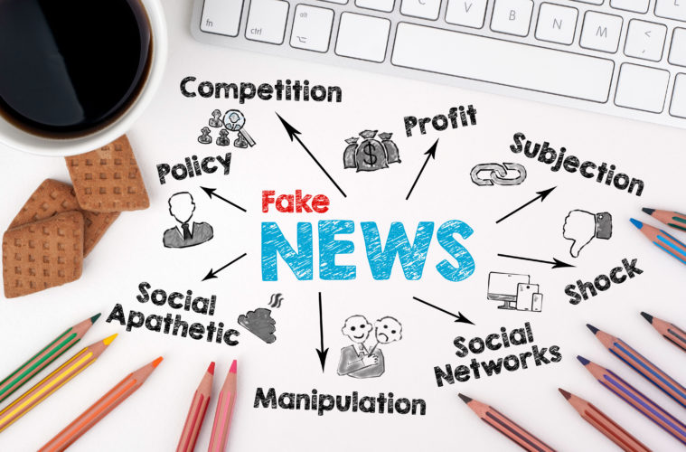
Motivation
Fake news is a mean to an objective, not an objective in and of itself.
The parties who commissioned the promotion of fake news sites do so with an objective in mind. While any media post can be considered biased to some extent, what differentiates fake news campaigns is that they are often generally based on fabricated, non-existent facts and often utilize shocking, clickbait titles in order to attract the reader’s attention.
Notes:
The importance of the title used for the headlines cannot be emphasized enough.
In today’s digital era, the attention span of a typical reader is very short. Fake news creators use this to manipulate the public. There’s no need for an article to be sensible, complete, or factual; a sensational headline will achieve the objectives just as well. In the current landscape, the objective is most commonly thought to be political. While this has been the dominant variety of fake news in some countries, other possible motives exist. Even if political fake news is the most commonly used today, the tools and techniques that enable them are becoming more available. It is inevitable that other motivations—such as profit—will come to the forefront in later years.

Slide 11
References
Bakir, V. & McStay, A. (2017). Fake News and the Economy of Emotions in Digital Journalism (Taylor and Francis).
RISJ (2018). Digital News Report 2018 (University of Oxford). http://media. digitalnewsreport.org/wp-content/uploads/2018/06/digital-news-report-2018. pdf?x89475
Silverman, C. (2015). Lies, Damn Lies and Viral Content. Tow Center for Digital Journalism. http://towcenter.org/wp-content/uploads/2015/02/LiesDamnLies_ Silverman_TowCenter.pdf
UNESCO (2017). States and journalists can take steps to counter ‘fake news’. https://en.unesco.org/news/states-and-journalists-can-take-steps-counter-fake-new

Slide 12
End of Unit 1

