Slide 1
Propaganda and manipulation
Unit 1: What is propaganda and manipulation? Why propaganda is so effective?

Slide 2
What is propaganda?
Propaganda is a form of manipulation of public opinion by the manipulation of representations. These representations may take spoken, written, pictorial or musical form [Lee, Chin-Chuan, 2000].

Slide 3
Propaganda works by tapping into emotions through:
news reports
government reports
historical revision
junk science or pseudoscience (read about it more https://en.wikipedia.org/wiki/List_of_topics_characterized_as_pseudoscience)
books
movies
social media
television
posters

Slide 4
Propaganda often is not objective
Usually part of a larger psychological campaign to influence people towards a specific opinion.
May include outright lies or more subtle misinformation and censorship.

Slide 5
The difference between Propaganda and Education
Remember! some propagandists may consider themselves as educators
BUT!
Educators try to present various sides of an issue.
Education aims to induce reactors to collect and evaluate evidence for themselves and assists them in learning the techniques for doing so.

Slide 6
Why propaganda is so effective?
Noam Chomsky, American linguist, philosopher and political activist:
“The easy thing to do [is] come home from work, you’re tired, just had a busy day, you’re not gonna spend the evening carrying on a research project, so you turn on the tube (TV), say it’s probably right, look at the headlines of the paper, then you watch sports or something. That’s basically how the system of indoctrination works…”
[Chomsky, Noam. 2000]

Slide 7
Propaganda system is successful
Propaganda system is successful because, quite simply, people are too busy to question whether the news headlines are truthful or not.
For more information you can watch this documentary:
Noam Chomsky. Manufacturing consent (1992)

Slide 8
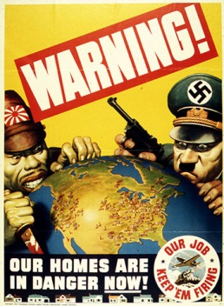
When propaganda is especially successful?
The most obvious examples of propaganda happen during wars or crises when governments try to rally their people against a common enemy, or sometimes imaginary enemy.
During World War I and World War II, posters depicting the enemy as evil were commonly used.

Slide 9
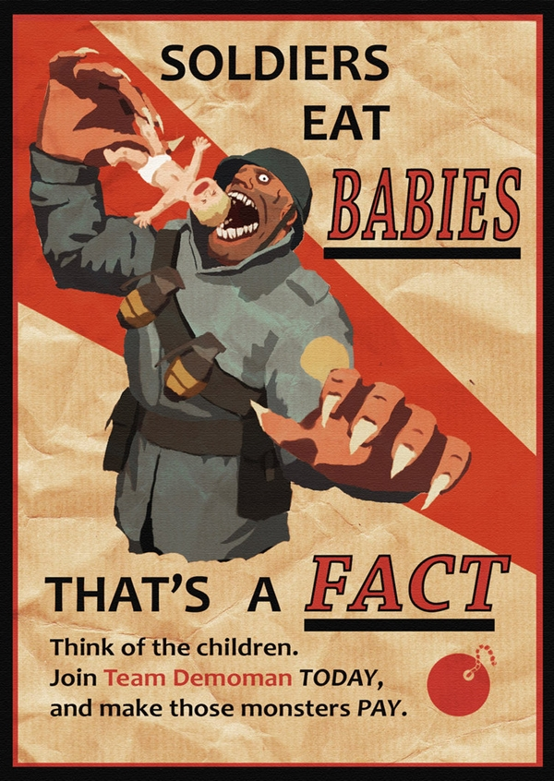
The information becomes propaganda when it is manipulative, close-minded and intemperate!!!
Propagandists do not play fair.
They exaggerate favorable evidence and ignore evidence to the contrary.

Slide 10
References
Barsamian, David., Chomsky, Noam. Propaganda and the Public Mind. South End Press: 2001. ISBN 100896086348
Chomsky, N.,Herman, E.: Manufacturing Consent: The Political Economy of the Mass Media., Pantheon: 2000
Stanley, Jason. How Propaganda Works. Princeton University Press: 2015. ISBN 9780691173429
Lee, Chin-Chuan.: Power, Money, and Media: Communication Patterns and Bureaucratic Control in Cultural China (Media Topographies)., Northwestern University Press: 2000

Slide 11
End of Unit 1

