Slide 1
Fake News
Unit 3: Fake news, Echo chamber and Filter bubble

Slide 2
Learning outcomes
Upon completing this unit, trainees should be able to:
Evaluate media found on the web for validity and accuracy & teach others to do the same.
Provide reasons why it is important to remain vigilant in seeking meaningful sources.
Distinguish fact-checkable claims from opinions and hyperbole .
Work with peers to develop a coordinated strategy for discussing these issues with our communities.

Slide 3
Following the surprise victories of Brexit and Trump in 2016, even the outgoing U.S. president Barack Obama (2017) warned in his farewell speech that “it’s become safer to retreat into our own bubbles”, thereby linking increased electoral volatility and ideological polarisation with concepts such as “echo chambers” (Sunstein 2001) and “filter bubbles” (Pariser 2011).
The politicians, journalists, and scholars who support these concepts suggest that, with online and social media as the primary sources of information for a growing percentage of the public (Newman et al. 2016), echo chambers and filter bubbles are chiefly responsible for the emergence of communities that espouse contrarian and counterfactual perspectives and ideologies, and for their disconnection from mainstream public debates.

Slide 4
Echo Chamber: The confirmation bias online
The echo chamber is the digital comfort-zone, made up of friends, contacts, follower who think it exactly like me.
In the echo chamber opinions and beliefs are amplified in real-time, thanks, to the power of social media media diffusion. They reverberate themselves and becomes facts.
In the echo chamber the divergent opinions are ignored, derided, underrepresented.
Notes:
The ‘echo chamber’ concept builds explicitly on Nicholas Negroponte’s mid-1990s vision of the Daily Me (Negroponte 1995): a Web 2.0-enabled, personalised news portal that would serve only those news items that are of relevance to the known interests of its user, and would therefore vary significantly across individual users.
While Negroponte’s own vision of this service was largely positive, Sunstein took a considerably more dystopian view and saw the Daily Me and similar services as leading to a fragmentation and atomisation of society that would mean that there was no longer a guarantee that all citizens participating in democratic processes would do so on the basis of a shared and broadly comparable information diet; in particular, he viewed the deep political divisions revealed in the disputed U.S. presidential election race between George W. Bush and Al Gore in 2000, and in its acrimonious aftermath, as a clear sign of such coming societal disintegration. Subsequently, Sunstein’s focus has shifted.

Slide 5
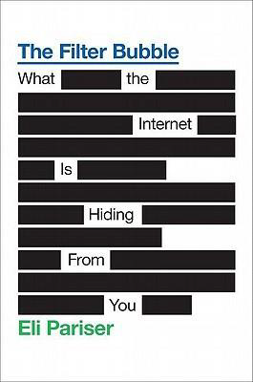
The filter bubble
The term was coined by Eli Parisier in his book of the same name
The filter bubble is the result of the algorithms present on social media, Facebook above all, and on search engines, first of all Google.
These algorithms offer more visibility to people, groups, sites and information to which we have already shown interest.
So that the user can stay in his social-informative comfort zone. But effectively strengthening his echo chamber.

Slide 6
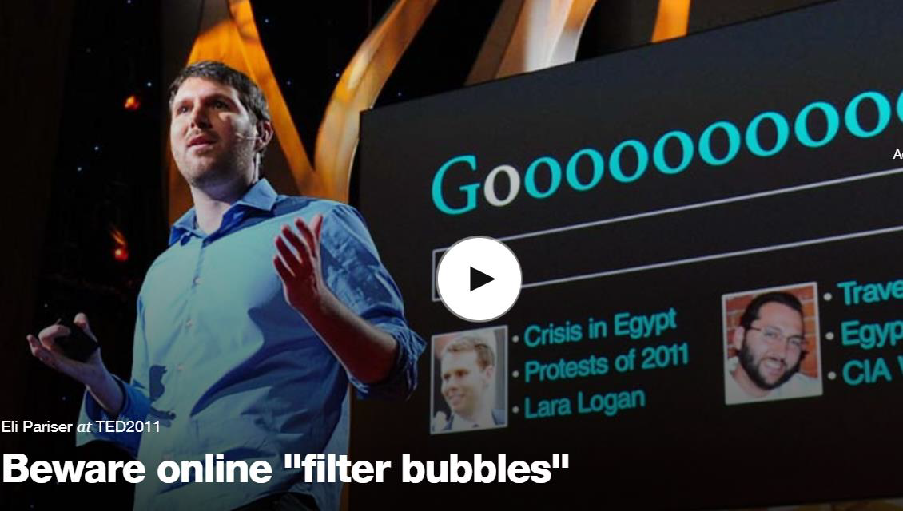
The filter bubble
Eli Parisier TEDTalk - https://www.youtube.com/watch?v=B8ofWFx525s
Notes:
It builds fundamentally on an anecdote Pariser recounts in his book:
In the spring of 2010, while the remains of the Deepwater Horizon oil rig were spewing crude oil into the Gulf of Mexico, I asked two friends to search for the term “BP.” They’re pretty similar – educated white left-leaning women who live in the Northeast. But the results they saw were quite different. One of my friends saw investment information about BP. The other saw news. For one, the first page of results contained links about the oil spill; for the other, there was nothing about it except for a promotional ad from BP. (Pariser 2011: 2)

Slide 7
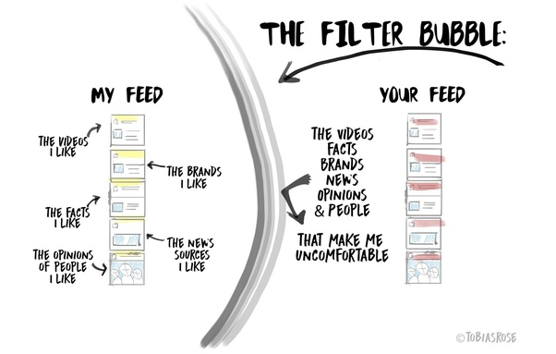
The filter bubble feeds on the Echo
As both echo chambers and filter bubbles have therefore remained somewhat moving targets in both public discourse and scholarly inquiry, one result has been the gradual conflation of the two.
Even as a growing number of research projects have sought to provide evidence for or against the existence of echo chambers and/or filter bubbles, the two terms have been used increasingly interchangeably; indeed, some scholarly publications openly use language such as “filter bubbles (aka ‘echo chambers’)”
Orellana-Rodriguez and Keane 2018

Slide 8
As the result, the only “interesting” topics identified by the algorithms are the ones of people who think exactly like us or who we totally disagree with.

Slide 9
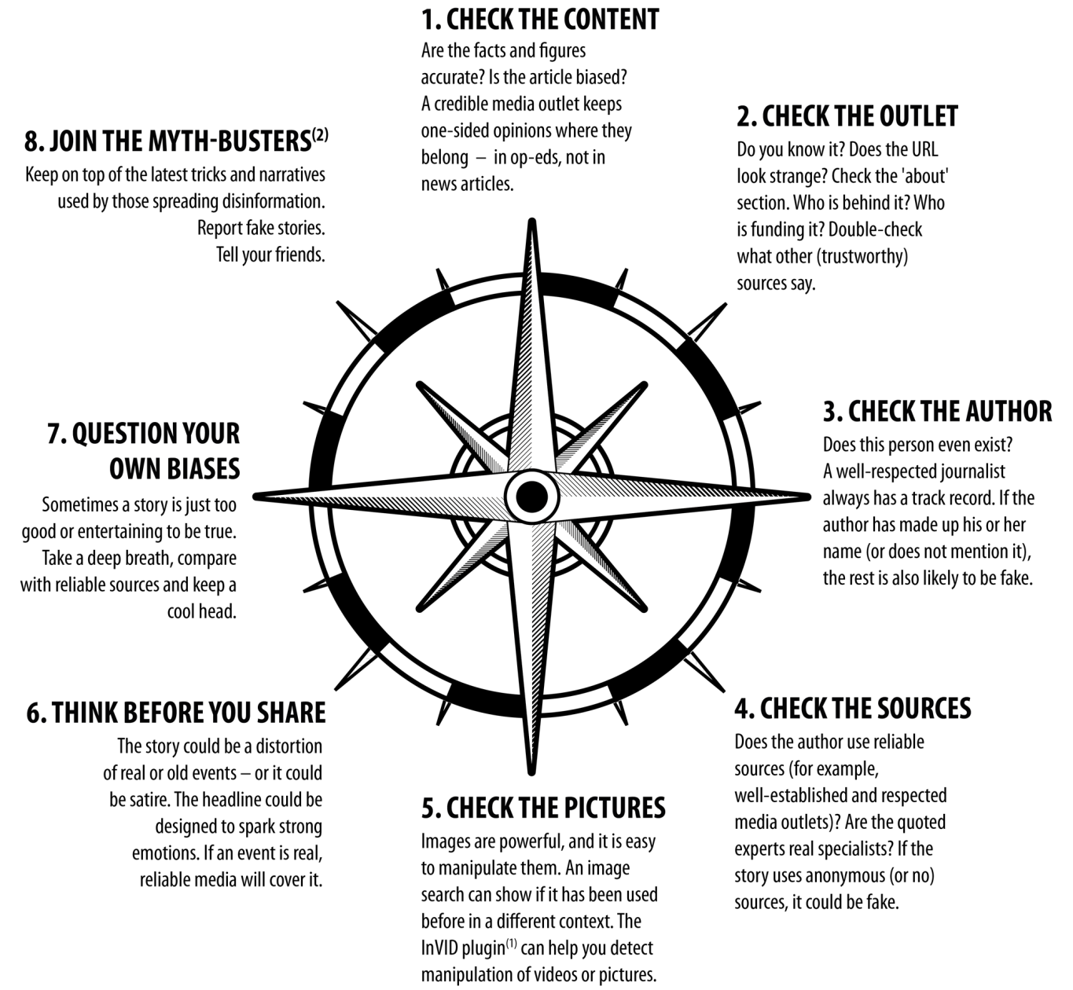
How to spot fake news
To help online users, the European Union has published the guide: “How to tell if a news story is fake”.
Notes:
This is an eight-point guide (available on the Parliament’s website in English) https://www.europarl.europa.eu/RegData/etudes/ATAG/2017/599386/EPRS_ATA(2017)599386_EN.pdf

Slide 10
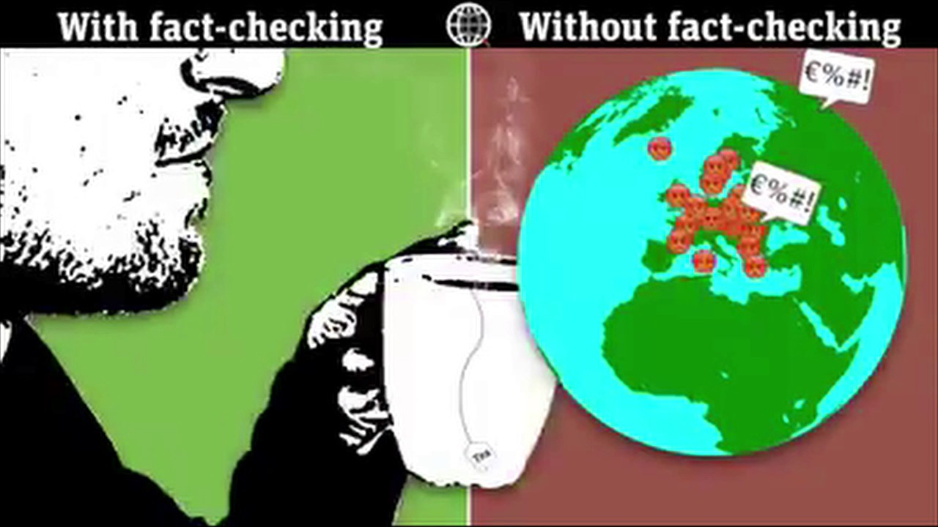
Fact checking online is more important than ever
https://www.youtube.com/watch?v=Ryjpu-NWYm8

Slide 11
IMVAIN
The bedrock method of deconstruction:
Each source in a news report is evaluated using the “IMVAIN” rubric and you can to:
Independent sources are preferable to self-interested sources.
Multiple sources are preferable to a report based on a single source.
Sources who Verify or provide verifiable information are preferable to those who merely assert.
Authoritative and/ or Informed sources are preferable to sources who are uninformed or lack authoritative background.
Named sources are better than anonymous ones.
Notes:
https://digitalresource.center/content/introducing-imvain

Slide 12
As an example of misinformation masquerading to fact-checking, check these two articles:
These fake fact-checkers are peddling lies about genocide and censorship in Turkey (Poynter) https://www.poynter.org/news/these-fake-fact-checkers-are-peddling-lies-about-genocide-and-censorship-turkey
In the post-truth era Sweden’s far-right fake fact checker was inevitable. (The Guardian) https://www.theguardian.com/media/2017/jan/19/ in-the-post-truth-era-swedens-far-right-fake-fact-checker-was-inevitable

Slide 13
Why fake news are stronger online?
Infobesity - Decrease in attention to details and nuances. Less desire to deepen an information.
Echo chambers and filter bubbles - If many people/friends in my groups online repeat that something is true, so that’s true.
Collapse of the context in content - Decontextualized texts, images and videos.
Manipulable online information - It’s easy to create fake content about real people and fake profiles of real people.

Slide 14
Resources - Tools for verifying
Fact Checkers
Factcheck.org FactCheck.org fact-checks claims made by presidents, members of Congress, presidential candidates, and other members of the political arena by reviewing TV ads, debates, speeches, interviews, and news releases.
PolitiFact: Fact-checking US politics Politifact fact-checks claims by politicians at the federal, state, and local level, as well as political parties, PACs, and advocacy groups and states the accuracy of these claims on its Truth-O-Meter.
Snopes Snopes.com was originally founded to uncover rumors that had begun cropping up in chain emails and message boards and is now highly regarded for its fact-checking.
Verification Handbook: An ultimate guideline on digital age sourcing Handbook is a step by step guide for verifying digital content initially created for reporters and emergency responders.
Verify Webpage History
Wayback Machine Web archive that captures websites over time and can be used to verify content history and edits.

Slide 15
Resources - Tools for verifying
Verify Images
Found an image you think may have been manipulated or photo-shopped? Use these tools to check for any digital changes:
FotoForensics Identify parts of an image that may have been modified or “photoshopped”.
Google Reverse Image Search Upload or use a URL image to check the content history or to see similar images on the web.
Google Street View Identifying the location of a suspicious photo or video is a crucial part of the verification process.
Jeffrey’s Exif Viewer Upload or enter the URL of an image and view its metadata.
TinEye Reverse Image Search Upload or enter an image URL to the search bar and see a list of related sites. Has plug-ins for your browser.
Wikimapia Crowd-sourced version of Google Maps, featuring additional information.
Want more tools? Check out the Verification Handbook's List of Tools

Slide 16
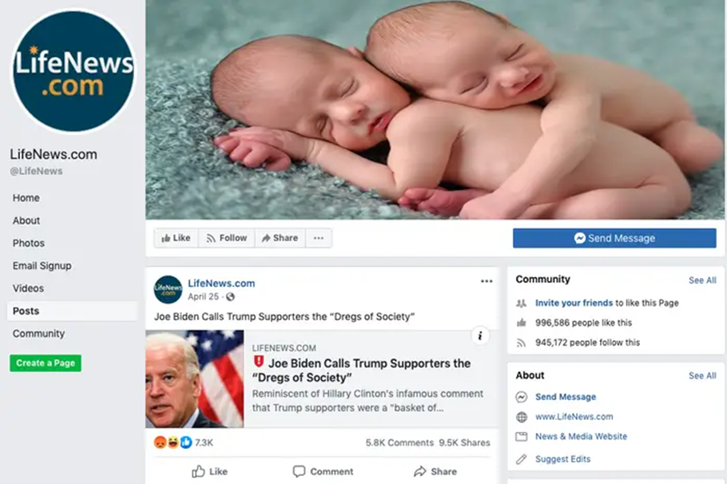
The 10 most-viewed fake-news stories on Facebook in 2019
10. "Joe Biden Calls Trump Supporters 'Dregs of Society'"
Notes:
You may use relevant Fake News of national country to create an EU-based list of fake news

Slide 17
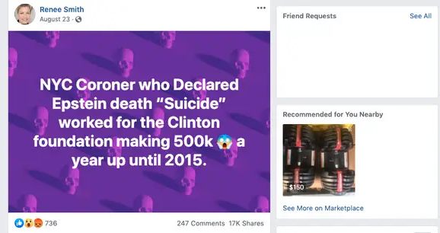
The 10 most-viewed fake-news stories on Facebook in 2019
9. "NYC coroner who declared the death of Jeffrey Epstein a suicide made half a million dollars a year working for the Clinton Foundation until 2015"

Slide 18
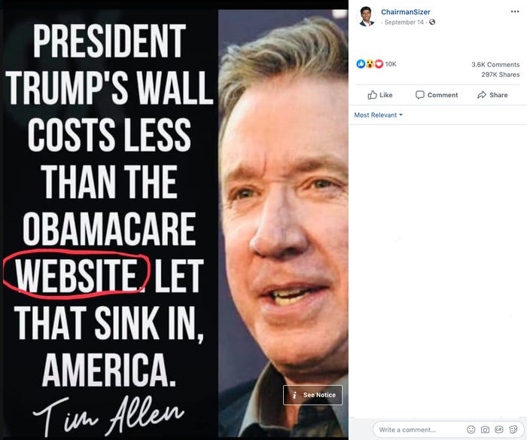
The 10 most-viewed fake-news stories on Facebook in 2019
8. "Tim Allen quote Trump’s wall costs less than the Obamacare website"

Slide 19
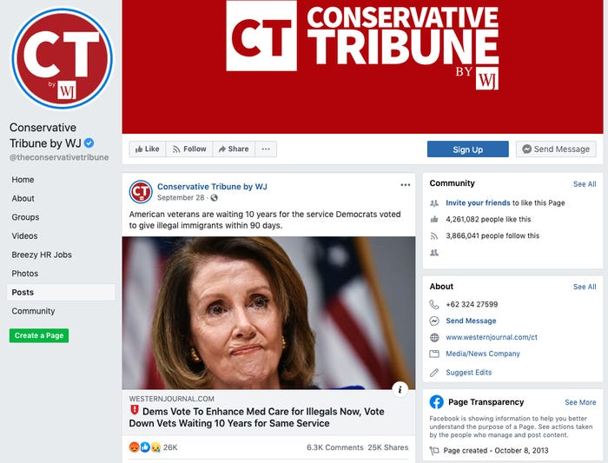
The 10 most-viewed fake-news stories on Facebook in 2019
7. "Democrats Vote To Enhance Med Care for Illegals Now, Vote Down Vets Waiting 10 Years for Same Service"

Slide 20
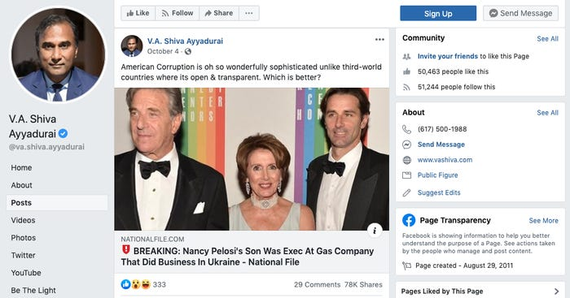
The 10 most-viewed fake-news stories on Facebook in 2019
6. "BREAKING: Nancy Pelosi’s Son Was Exec At Gas Company That Did Business In Ukraine"

Slide 21
The 10 most-viewed fake-news stories on Facebook in 2019
5. "Ilhan Omar Holding Secret Fundraisers With Islamic Groups Tied to Terror"

Slide 22
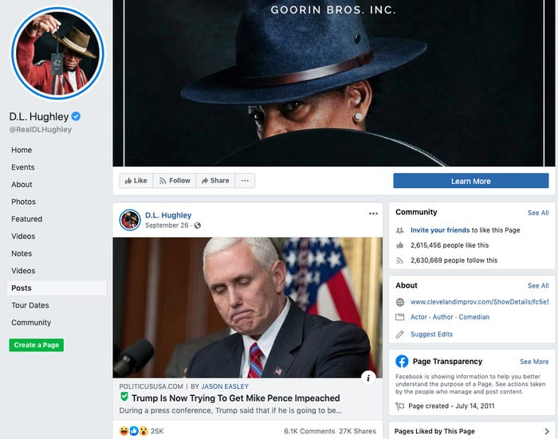
The 10 most-viewed fake-news stories on Facebook in 2019
4. "Trump Is Now Trying To Get Mike Pence Impeached"

Slide 23
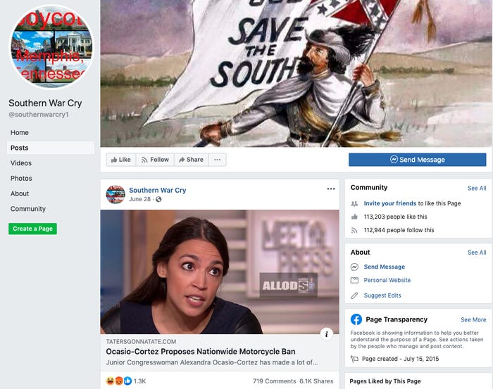
The 10 most-viewed fake-news stories on Facebook in 2019
3. "AOC proposed a motorcycle ban"

Slide 24
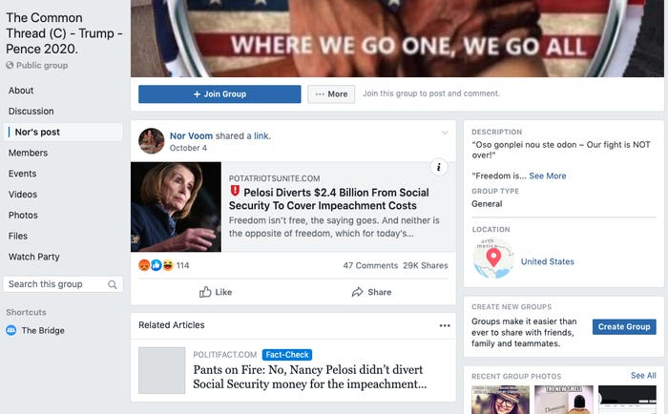
The 10 most-viewed fake-news stories on Facebook in 2019
2. "Nancy Pelosi diverting Social Security money for the impeachment inquiry"

Slide 25
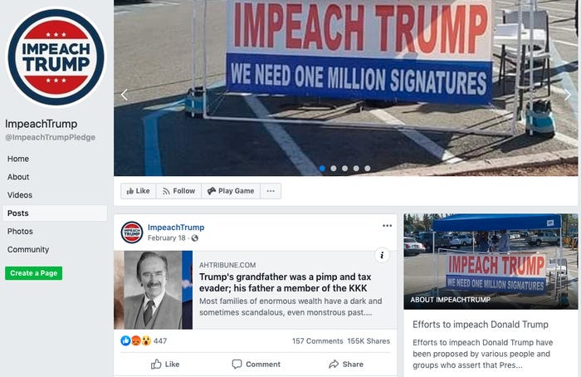
The 10 most-viewed fake-news stories on Facebook in 2019
1. "Trump’s grandfather was a pimp and tax evader; his father a member of the KKK"

Slide 26
Additional resources
From Headline to Photograph: a Fake News Masterpiece This January 2017 article deconstructs how one successful viral fake news story was created, and why.
Social Media and the Spread of Fake News This December 2016 article discusses the viral spread of certain fake news articles.

Slide 27
End of Module

