Slide 1
Propaganda and manipulation
Unit 2: Propaganda Techniques

Slide 2
Advertisers, influencers, and politicians have been using propaganda techniques for generations.
Here are the most popular of them:
Bandwagon Propaganda
Logical Fallacies
The appeal to emotion
Card Stacking Propaganda
Testimonial Propaganda
Name Calling Propaganda
Transfer Propaganda

Slide 3
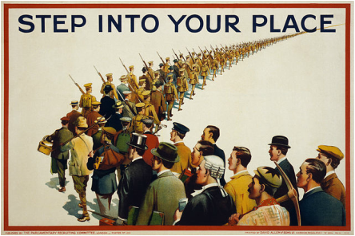
Bandwagon Propaganda
Common effect in which someone adopts a trend or belief because the majority of people already adopted it.
For more detailed information watch this Video

Slide 4
Logical fallacies
Breakdown of logic
A fallacious argument is one that tries to argue from A to B, but because it contains hidden assumptions or factual irrelevancies, reaches an invalid conclusions
Watch this video to learn more

Slide 5
Logical fallacies
Examples

Slide 6
The Appeal to Emotion
The appeal to emotion is a logical fallacy used to encourage the audience to ignore facts that their opponent brought up, by attempting to elicit anger, resentment, and distrust against their source.
Watch this video to learn more

Slide 7
Card Stacking Propaganda
Card stacking propaganda is a way to manipulated information order to make something look better. It exaggerates the positive facts and figures and hides negative information.

Slide 8
Card stacking propaganda
Examples

Slide 9
Testimonial propaganda
Testimonial propaganda is popular propaganda technique that uses renowned or celebrity figures to endorse products and services. Now in this case, when a famous person vouches for something, people are likely to take account of the credibility and popularity of that person.
Watch this video to learn more

Slide 10
Testimonial propaganda
Examples

Slide 11
Name Calling Propaganda
This propaganda technique involves using derogatory or critical phrases to create a negative opinion about someone or something.

Slide 12
Name Calling Propaganda
Examples

Slide 13
Transfer Propaganda
Uses a technique to project certain qualities (this can either be positive or negative) of a person, ideology or object to other things and people.
Watch this video to learn more
https://www.youtube.com/watch?v=FcYicVG3hgA

Slide 14
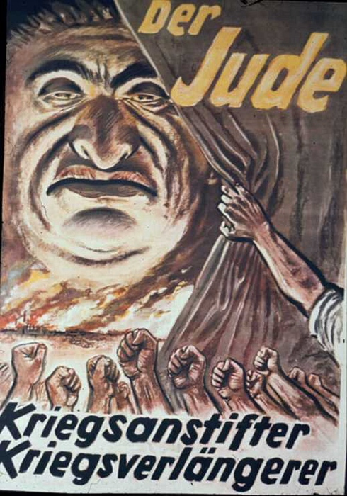
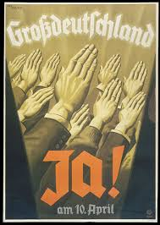
Quiz!
Find out all the propaganda techniques used on the following posters:

Slide 15
References
Conserva, Henry. Propaganda Techniques., AuthorHouse: 2003
O'Sullivan, Carol., Television: Identifying Propaganda Techniques. Greenhaven Pr: 1990. ISBN-13: 978-0899086064
Shabo, Magedah. Techniques of Propaganda and Persuasion., Prestwick House, Inc.: 2008

Slide 16
End of Unit 2

