Slide 1
Media Literacy
Unit 1: What is Media Literacy?

Slide 2
Objectives
By the end of this unit you should be able to:
Define what Media Literacy is
Understand the importance of Media Literacy
Learn how to be media literate

Slide 3
Definition of Media Literacy
What is Literacy?
Literacy is the capacity to communicate using inscribed, printed, or electronic signs or symbols for representing language. Literacy is customarily contrasted with oral tradition, which encompasses a broad set of strategies for communicating through oral and aural media. In real world situations, however, literate and oral modes of communication coexist and interact, not only within the same culture but also within the very same individual.
(Encyclopaedia Britannica: https://www.britannica.com/topic/literacy).
What is Media Literacy
Media literacy involves the ability to effectively use different types of media. A digitally literate person reads and understands the meaning of the messages conveyed through the Internet, press, television, video games, music, images, and radio.
Media literacy functions as a medium for responding to the technological development of contemporary societies.

Slide 4
Definition of Media Literacy
According to the European Commission, Media Literacy represents a variety of skills and competences related to the media, its images, languages and messages:
“Media Literacy may be defined as the ability to access, analyse and evaluate the power of images, sounds and messages which we are now being confronted with on a daily basis and which are an important part of our contemporary culture; as well as to communicate competently using media available, on a personal basis. Media Literacy relates to all media, including television and film, radio and recorded music, print media, the Internet and other new digital communication technologies”
“Study on the Current Trends and Approaches to Media Literacy in Europe”
https://ec.europa.eu/culture/library/study-current-trends-and-approaches-media-literacy-europe_en

Slide 5
History of Literacy
Alphabetical skills Amplification and Audiovisual literacy Digital + Media
expansion of literacy literacy
Alphabetical Writing
Printing of books and the press
Appearance of electronic media: telephone, film, radio and television
Digital media and Internet

Slide 6
Media Literacy involves
Media Literacy involves
• The development of skills in working with technology;
• Appreciation of audio-visual heritage;
• Protection of children against harmful content, and the development of their awareness of online risk;
• Promotion of the inclusion of excluded groups in using technology, and in the ‘knowledge society’;
• Promotion of independent public service media;
• Resistance on commercial persuasion, and raise awareness of new marketing practices;
• Promotion of active citizenship and active participation in civil society;
• Promotion of creative and artistic self-expression through the use of new media, enabling people to communicate with audiences;
• Promotion of equality of opportunity, tolerance and diversity – and human rights;
• Taking informed decisions as media consumers.
“Study on the Current Trends and Approaches to Media Literacy in Europe” https://ec.europa.eu/culture/library/study-current-trends-and-approaches-media-literacy-europe_en

Slide 7
Why is Media Literacy important?
Critical Thinking
Stay informed and up to date
MEDIA LITERACY
Self- Expression
Active Citizenship
Personal Development
Know how to find, retrieve
and use information
correctly

Slide 8
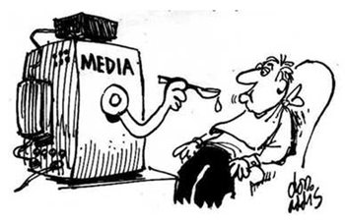
Why is Media Literacy important?
Critical Thinking
Evaluate the quality of information received and transmitted.
Active citizenship
Actively participate in the social community contributing in local, national and/ or global level.
Stay informed and up to date
Take informed decisions online and/ or offline.
Self- Expression
Express freely, in a creative way using the media.
Know how to find, retrieve and use information correctly
Create content with the use of media and the information received.
Personal Development
Develop oneself in terms of communication skills, research, open-mindedness and critical thinking.

Slide 9
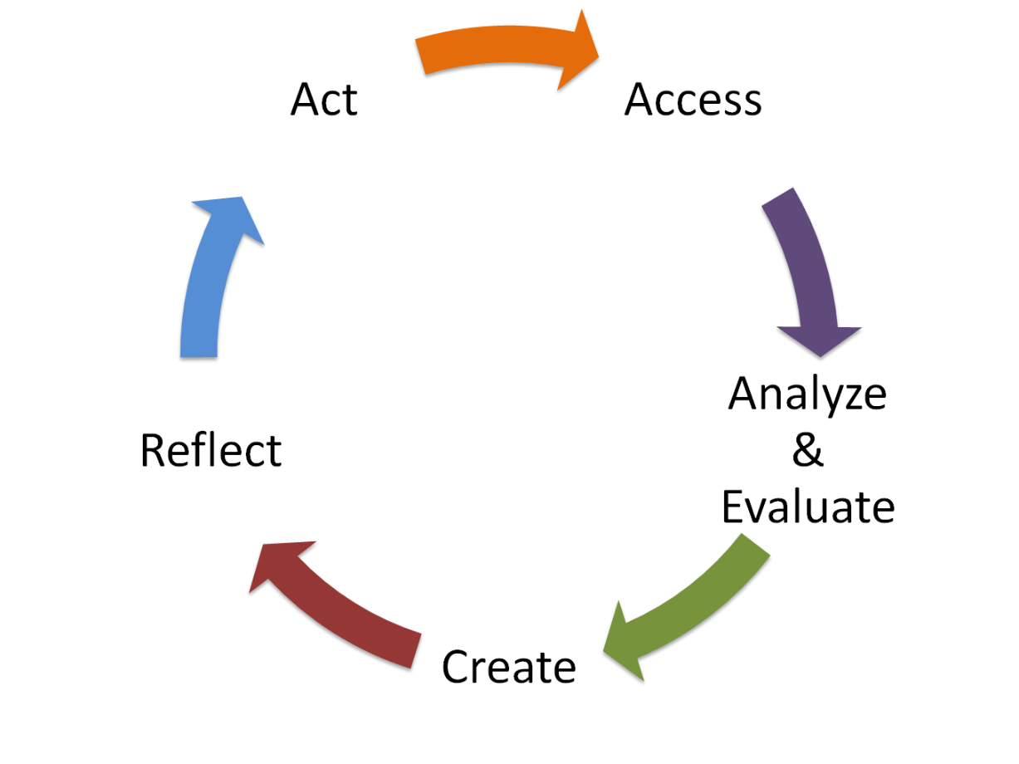
How to evaluate Media Literacy
?
There is a need to evaluate resources before using and/ or (re)acting on them.
Cross-check resources, and distinguish between fact and opinion.

Slide 10
Fact Vs Opinion
https://blog.ananddamani.com/fact-and-opinion-the-filtering-process-bbb1408b234f

Slide 11
Activity 1
Identify whether the statements below are a fact or an opinion and explain why.
1. Lord of the Rings: Return of the King won eleven Oscars (Academy Awards)
Fact or Opinion Explain:
2. Oranges contain both calcium and vitamin C.
Fact or Opinion Explain:
3. The more money someone has the more successful they are.
Fact or Opinion Explain:
4. Facebook is of high quality social media nowadays.
Fact or Opinion Explain:
5. A digitally literate person takes more informed decisions.
Fact or Opinion Explain:
Notes:
Answers:
1. Fact
2. Fact
3. Opinion
4. Opinion
5. Opinion

Slide 12
How to choose your news?
How do we know what is happening in the world? How do we choose the news we follow?
Watch this video to get a side scoop on how the opinions and facts (and sometimes non-facts) make their way into the news and how the smart reader can tell them apart.
Notes:
After you watch the video, start a discussion on what you have watched and reflect on the video by asking the young people:
if they agree,
if they have any other suggestions themselves on how to evaluate the news/ sources and
how they themselves choose their news.
Link: https://www.youtube.com/watch?v=q-Y-z6HmRgI&list=PLJicmE8fK0EjWxWJW83K4z93wmtxtanHG

Slide 13
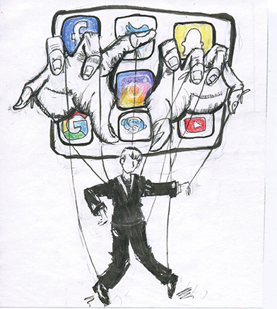
How and why a specific message is being delivered?
To better understand and evaluate how and for what reason a message is being delivered to us we may ask ourselves the following:
Who has created this message?
How is it constructed?
What is being left out?
What is their goal?
Do I agree with what is being said?
Is this message targeted to a local, national or a local audience?
Who is indented for?
“Media Literacy Explained”, 2016. https://www.youtube.com/watch?v=AD9jhj6tM50

Slide 14
Activity 2 (part 1)
Read the two articles:
1. Youth Guarantee – EU answer to the NEET problem
https://youthemploymentmag.net/2019/12/15/youth-guarantee-eu-answer-to-the-neet-problem/
2. The two contrasting sides of German refugee policy
https://www.thenewhumanitarian.org/news-feature/2019/11/11/German-refugee-integration-policy

Slide 15
Activity 2 (part 2)
Now, answer the questions:
- Who has created this message?
- How is it constructed?
- What is their goal?
- For whom is it indented for?
- Is this message targeted to a local, national or a local audience?
- Do you agree with what is being said?
Notes:
Article 1:
- Who has created this message? The Youth Employed Magazine
- How is it constructed? It includes facts, statistics and quotes from official documents of EU. It is an informative article.
- What is their goal? The goal is to present the situation of NEETs in EU and the efforts for solutions that have been made so far.
- For whom is indented for? For young people mostly- specifically NEETs.
- Is this message targeted to a local, national or a local audience? To EU citizens.
- Do you agree with what is being said? This is not an opinion article. It is created to present some facts and the programme running to help NEETs. However, a discussion can be developed to evaluate the role of EU in this effort of the programme “Youth on the Move”.
Article 2:
-Who has created this message? A freelance journalist who has reported on social affairs, international politics, and refugees from Europe, the United States, and Africa.
- How is it constructed? It’s an article that it is based on true stories of refugees and backs up these stories with some facts and statistics by national reports.
- What is their goal? The goal is to present the two contrasting sides of German refugee policy.
- For whom is indented for? This is indented for the general audience and policy makers even.
- Is this message targeted to a local, national or a local audience? To national audience and even a European one.
- Do you agree with what is being said? This is an article that shares some true facts and policies. One can disagree ad agree with the way Germany is presented to the general audience and with the decisions made.

Slide 16
Evaluation
What is media literacy?
Why is Media Literacy important?
How can we identify if a statement is a fact or an opinion?
How do you evaluate a message transmitted to you?
Notes:
Answers:
What is media literacy? (Answer in Slide 4)
Media literacy involves the ability to effectively use different types of media…
Why is Media Literacy important? (Answer in Slide 9)
Enhances Critical Thinking, empowers people to be active as citizens and develop themselves…etc.
How can we identify if a statement is a fact or an opinion? (Answer in Slide 11)
A fact is supported by evidence; an opinion is just a person’s point of view.
How do you evaluate a message transmitted to you? (Answer in Slide 14)
By answering some questions (slide 14), cross-checking resources to understand if the message transmitted is true and follow reliable sources.

Slide 17
References
Damani, Anand. 2012. “Fact and Opinion: The Filtering Process”. Last retrieved 23.12.2019. https://blog.ananddamani.com/fact-and-opinion-the-filtering-process-bbb1408b234f
Encyclopaedia Britannica. Last retrieved 23.12.2019. https://www.britannica.com/topic/literacy
European Commission. 2007 Report. “Study on the Current Trends and Approaches to Media Literacy in Europe”. Last retrieved 23.12.2019. https://ec.europa.eu/culture/library/study-current-trends-and-approaches-media-literacy-europe_en
“How to choose your news”. 2014. https://www.youtube.com/watch?v=q-Y-z6HmRgI&list=PLJicmE8fK0EjWxWJW83K4z93wmtxtanHG
“Media and Information Literacy”. 2016. https://www.youtube.com/watch?v=lxSYtwaXo2M
Martens, Hans; and Renee, Hobbs. 2013. “How Media Literacy Supports Civic Engagement in a Digital Age”. Atlantic Journal of
Communication, 23:2, 120-137, DOI: 10.1080/15456870.2014.961636.
Kubey, Robert. 1997. “Media Literacy in the Information Age. Current Perspectives”. Transaction Publishers. Last retrieved 23.12.2019. https://books.google.com.cy/books?id=rpdHWLVwnikC&pg=PA69&dq=media+literacy&hl=el&sa=X&ved=0ahUKEwjSwZ_P2L7mAhWMzIUKHb4qAXwQ6AEIcDAI#v=onepage&q&f=false
Potter, W. James. 2011. “Media Literacy”. Sage Publications Inc. Last retrieved 23.12.2019. https://books.google.com.cy/books?id=hTAII20unzwC&printsec=frontcover&dq=media+literacy&hl=el&sa=X&ved=0ahUKEwjSwZ_P2L7mAhWMzIUKHb4qAXwQ6AEIZzAH#v=onepage&q&f=false
The New Humanitarian. 2019. “The two contrasting sides of German refugee policy”. Last retrieved 23.12.2019.
https://www.thenewhumanitarian.org/news-feature/2019/11/11/German-refugee-integration-policy
Youth Impact. 2019. “Youth Guarantee – EU answer to the NEET problem”. Last retrieved 23.12.2019. https://youthemploymentmag.net/2019/12/15/youth-guarantee-eu-answer-to-the-neet-problem/

Slide 18
End of Unit 1

